Slide 1
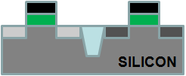
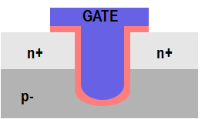
One path to solving the dopant activation problem: Recessed Channel Transistors with Activation before Layer Transfer
Idea 1: Activate dopants before layer transfer
Layer transfer of un-patterned film. No alignment issues.
Oxide
n+ Si
p
p Si
p
p- Si wafer
n+
H
n+
p- Si wafer
Idea 2: Recessed channel transistors @ sub-400ºC
Idea 3: Thin-film Si → perfect alignment. TSVs minimum feature size.
n+
n+
Minimum feature size TSVs
All steps after layer transfer to Cu/low k @ < 400ºC!
p
p

